Slide 1
Cobra - New Project Setup Procedure
From Cobra 8.0 Help
Create the Project
  When you set up a new project in Cobra, you define all the basic information about the project, including the code files, calendar, resource, and rate files associated with the project.
Before creating a project in Cobra, Create the following data sets that will be linked to the project. Each is described in detail in the next pages of this document:
  Calendar – Copy or create a new calendar for use by the project
    A calendar contains information about the project’s reporting period and period of performance. Since each project might have different periods, it’s helpful to have a unique calendar for each project
  Code files
    Code files provide “lookup”, validation and hierarchy (parent/child) for certain project data. In other words, if certain values are not in a Code table, you can’t select or import them into a project and you may not be able make summary reports at desired levels.
  Rate files
    Rate files contain multiplication factors that are applied to resources used in a project. Hours, for example are multiplied by an associated Direct rate to determine the direct cost for hours. Other rate factors (or burdens) can be applied next until the total cost is determined.
  Resource
    The resource table is a list of Labor, Materials, Subcontractors and Other costs used in a project. The Resource table is where a Cobra user applies Rates from the file above to calculate project budgets and estimates.
    Note - Actual costs, unlike budgets and estimates, are usually not calculated using resources' associated rates – more on this later

Slide 2
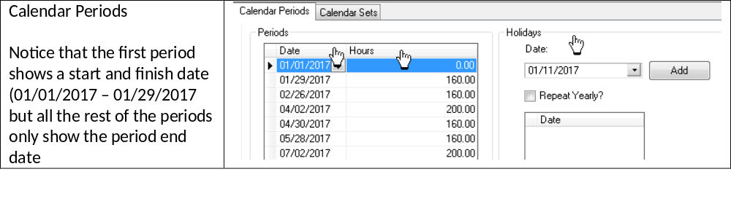
Cobra - New Project Setup Procedure
Calendars - Making and Using Calendars in Cobra
  Projects use calendars to define their reporting periods, which can be months, weeks or any other reporting periods Calendars also define the project’s “To Date” period, “Previous” period and “At Complete” period. Because these periods may be different for each project in Cobra, it’s a common practice to have a unique calendar for each project.
  The components of a Calendar are as follows:
  Calendar Periods is a table containing “Date”, “Hours” and “Holidays”
    Date is the end date of the reporting period with the exception of the first date in a calendar being the beginning of the period.
    Hours is the number of hours in the reporting period. Hours can be entered manually or you can enter Holidays to derive the number of hours in each period
    Holidays are used as an alternative to entering the number of hours in each calendar period

Slide 3
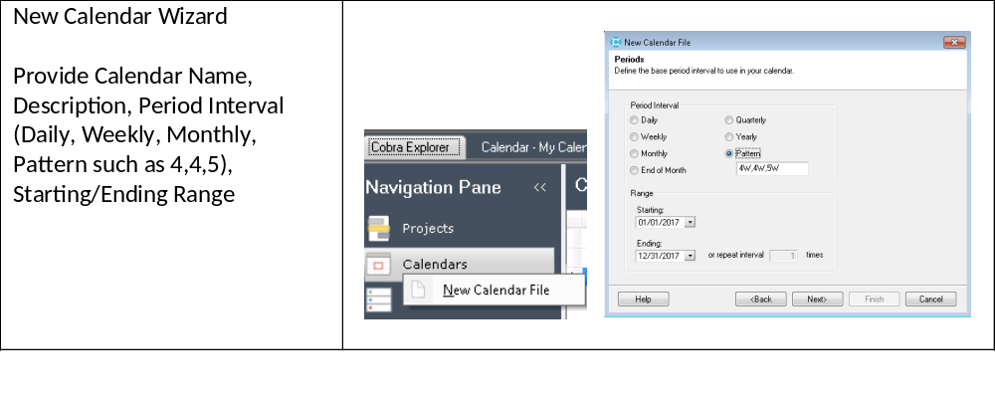
Cobra - New Project Setup Procedure
Calendars - Making and Using Calendars in Cobra
  Make a Cobra Calendar Using the New Calendar Wizard
    Start Cobra and Select the Cobra Explorer
    Right-Click on Calendars and select New Calendar File
    Follow the prompts and instructions to enter the calendar Period Interval, Starting and Ending Range, then Click Next

Slide 4
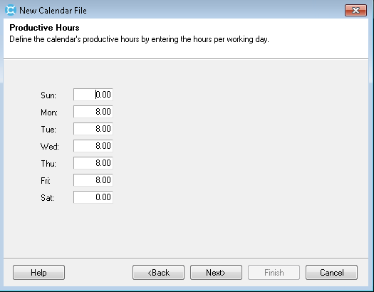
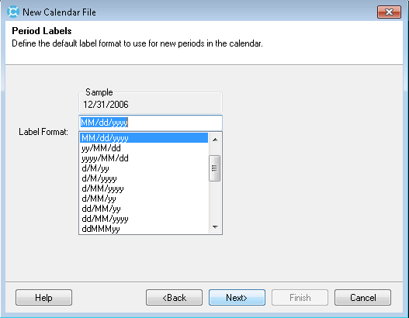
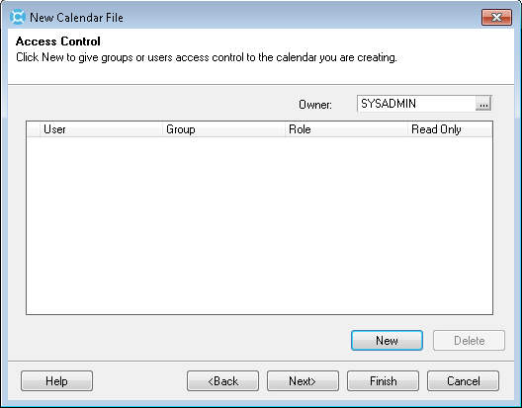
Cobra - New Project Setup Procedure
Calendars - Making and Using Calendars in Cobra
  Make a Cobra Calendar Using the New Calendar Wizard (Continued)
    Use the Productive Hours form to enter hours by day of the week then click Next. (Note – in a later step, you will be able to also enter specific Holidays to calculate total hours per reporting period)
    Use the Period Labels form to enter the pattern or format for Period Labels then click Next.
    Use the Access Control form to add Users or classes of users such as SYSADMIN or GUEST if necessary then click Finish

Slide 5
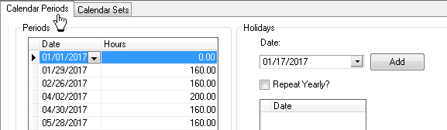
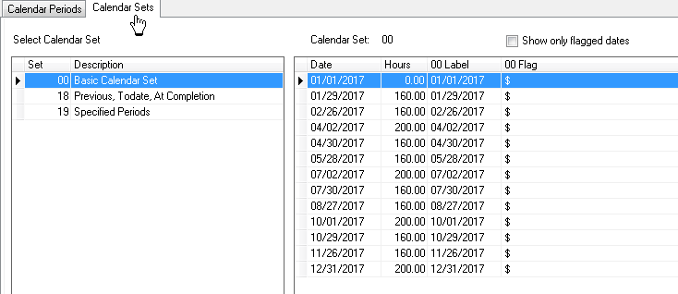
Cobra - New Project Setup Procedure
Calendars - Making and Using Calendars in Cobra
  Make a Cobra Calendar Using the New Calendar Wizard (Continued)
    Click on the tabs named Calendar Periods and Calendar Sets to see calendar period details
      Specific Holidays can be added to each period on the Calendar Periods tab. Entering a holiday will reduce the number of Hours in its associated Period
      Calendar Sets will include three mandatory Calendar Sets numbered 00, 18 and 19. See the next page for additional details about Calendar Sets

Slide 6
Cobra - New Project Setup Procedure
Calendars - Making and Using Calendars in Cobra
  Calendar Sets
    Set 00 - is a complete list of all calendar periods (by their end date – with the exception of the first entry showing the start date of the first period) .
    Each entry shows “$” in the 00 Flag column which just means it is not a floating period. Other calendar sets contain “Floating” period flags showing the Current & Prior reporting period and the At Complete period.

Slide 7
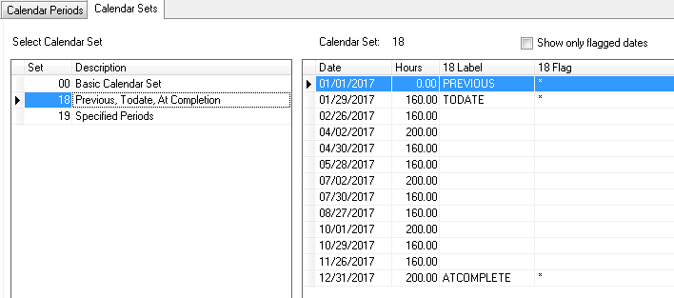
Cobra - New Project Setup Procedure
Calendars - Making and Using Calendars in Cobra
  Calendar Sets
    Set 18 - shows the same periods as Set 00 but it also indicates the floating periods of TODATE (the current reporting period), PREVIOUS (Prior reporting period) and ATCOMPLETE (the last reporting period for the project).
    The Column named 18 Flag must show a “*” next to each floating periods
    Moving the Floating Periods can be done by selecting a period data and right-clicking or by simply typing PREVIOUS, TODATE and ATCOMPLETE in the Label column
    Setting floating periods in Calendar Set 18 is used for generating certain reports such as the CPR Format 1

Slide 8
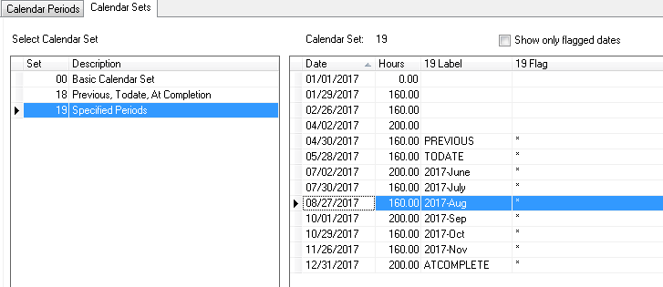
Cobra - New Project Setup Procedure
Calendars - Making and Using Calendars in Cobra
  Calendar Sets
    Set 19 – is used to flag and label other floating reporting periods used by reports such as the CPR Formats 3 and 4 for 6 Month Forecast by Month

Slide 9
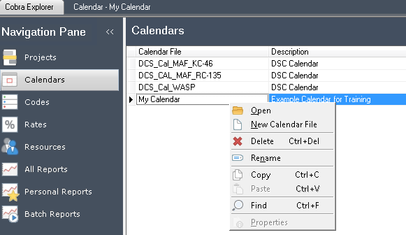
Cobra - New Project Setup Procedure
Calendars - Making and Using Calendars in Cobra
  Copy an Existing Calendar
    Select Calendars from the Cobra Explorer
    Right-click on an existing calendar and select Copy
    Once the copy has been created, Right-click or Double-click to open its Calendar periods and Calendar Sets

Slide 10
Cobra - New Project Setup Procedure
Code Files - Making and Using Code Files in Cobra
  Code file can simply be used as a flat (meaning there is no parent/child hierarchical structure) lookup list for certain data in a project such as Manager. Code file can also be hierarchical which gives you the ability to summarize data in Cobra at any level of the hierarchy.
  The components of a Code File are as follows:
    Code is the end date of the reporting period with the exception of the first date in a calendar being the beginning of the period.
    Description is the number of hours in the reporting period. Hours can be entered manually or you can enter Holidays to derive the number of hours in each period
    Parent/Child Relationship or hierarchical structure

Slide 11
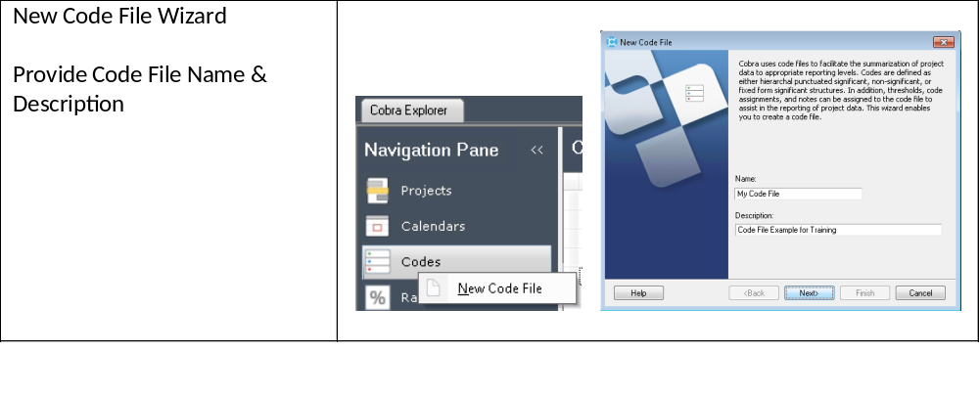
Cobra - New Project Setup Procedure
Code Files - Making and Using Code Files in Cobra
  Make a Cobra Code File Using the New Code File Wizard
    Start Cobra and Select the Cobra Explorer
    Right-Click on Codes and select New Code File
    Enter the Code File Name & Description then Click Next

Slide 12
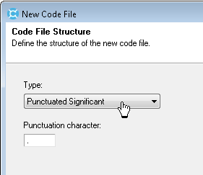
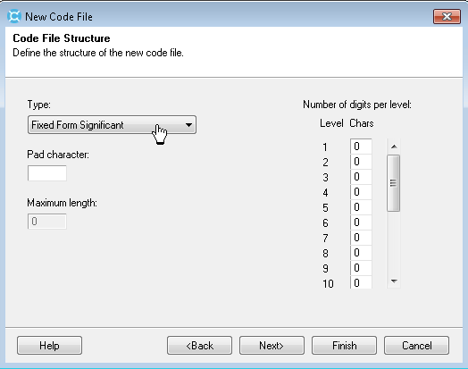
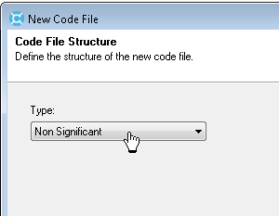
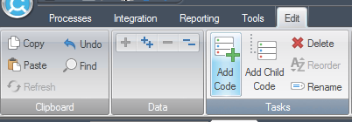
Cobra - New Project Setup Procedure
Code Files - Making and Using Code Files in Cobra
  Make a Cobra Code File Using the New Code File Wizard (Continued)
    Specify, by Type, if codes will be:
      Punctuation Significant meaning the reporting hierarchy is implied by the code itself.
      “1.1.1”, for example is a 3rd level item in a hierarchical structure in a Punctuation Significant (by a dot as its Punctuation character) code structure. The parent of “1.1.1” is “1.1” which, in turn, has a parent of “1”.
      If Codes are
      Fixed Form Significant meaning that the number of characters and character position identifies the hierarchical structure
      “1.1.1”, for example is a 3rd level item in a hierarchical structure in a Punctuation Significant (by a dot as its Punctuation character) code structure. The parent of “1.1.1” is “1.1” which, in turn, has a parent of “1”.
      If Codes are
      Non Significant the user can define the parent/child relationships without relying on Fixed characters or a Punctuation Character
    Click Add Codes and Child Nodes on the Edit menu or Import Codes using the Integration Wizard

Slide 13
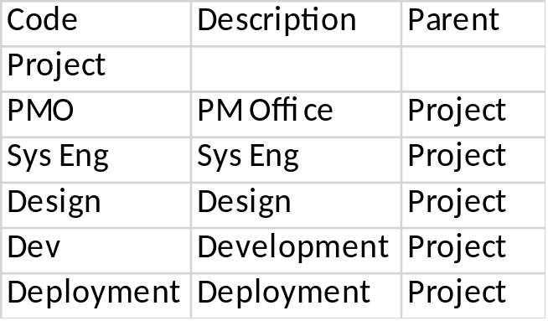
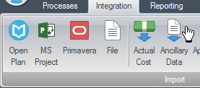
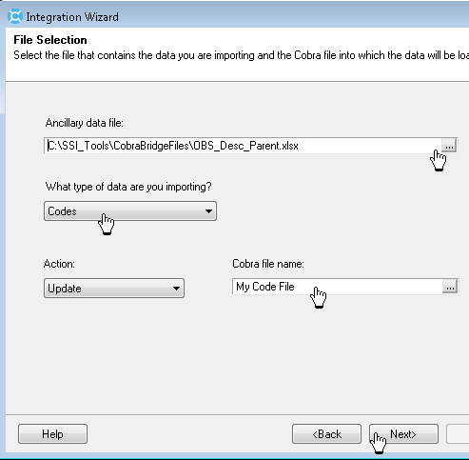
Cobra - New Project Setup Procedure
Code Files - Making and Using Code Files in Cobra
  Import Codes from an Excel or CSV file Using the Ancillary Data Integration Wizard
    Make a new code file using the Code File Wizard following Steps 1 – 3 on the previous page.
    Make a simple Excel worksheet with three columns like the one shown to the left. Note that the first line has no Parent and all the next lines show the Code of the first line, “Project” as their Parent. This example makes a simple two level code file where “Project” is level 1 and “PMO”, “Sys Eng”, “Design”, “Dev” and “Deployment” are its child codes
    Select Ancillary Data from Cobra’s Integration menu
    If this is a new integration, just select Create a new configuration and press Next. If this is similar to a prior saved Integration configuration then select Open a existing configuration and press Next.
    Now browse for the Excel or CSV file that contains the Code, Description and Parent data.
    Enter Codes below “What type of data are you importing”
    Select the name of the Code file below “Cobra file name” and press Next.
    Save the integration configuration if you want to save a few steps next time then press Next

Slide 14
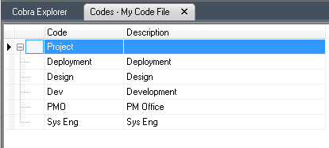
Cobra - New Project Setup Procedure
Code Files - Making and Using Code Files in Cobra
  Import Codes from an Excel or CSV file Using the Ancillary Data Integration Wizard (Continued)
    Use the Access Control form to add Users or classes of users such as SYSADMIN or GUEST if necessary
    Click Finish to begin import processing of the Code File data. If all goes well, you will receive confirmation that the Integration was Completed successfully
    Open the code file by selecting Codes in the Cobra Navigation Pane.

Slide 15
Cobra - New Project Setup Procedure
Rate Files - Making and Using Rate Files in Cobra
  Rate files contain multiplication factors that are applied to resources used in a project. Hours, for example are multiplied by an associated Direct rate to determine the direct cost for hours. Other rate factors (or burdens) can be applied next until the total cost is determined.
  The components of a Rate File are as follows:
    Rate Set & Description is the identifying name and description of the rate
    Date is the effective date (or start date) when the Rate Value is applied
    Value is the multiplication factor used to burden resources having the rate applied.
As an simple example, a rate file may include the 2 items shown
in the table to the right.
Later when you make a Resource File you can identify the names of the
Engineering staff members and specify that every hour of Engineering
labor is multiplied by the Engineering Direct Rate per its period of
performance ($75/hour if in 2017 or $77.50 if in 2018).
Additionally, you can specify that Engineering labor has Labor Overhead applied on top of its direct hourly rate. Therefore an hour of Engineering labor in 2017 is estimated to cost $75.00 plus 82% of $75.00 for a total burdened estimated cost of $136.50
Rate Set | Description | Date | Value
Labor Overhead | Overhead to be applied to labor | 1/1/2017 1/1/2018 | .82 .80
Engineering Direct Rate | Direct Eng Rate/hour | 1/1/2017 1/1/2018 | 75.00 77.50

Slide 16
Cobra - New Project Setup Procedure
Rate Files - Making and Using Rate Files in Cobra
  How to Make a Cobra Rate File Using the New Rate File Wizard
    Start Cobra and Select the Cobra Explorer
    Right-Click on Rates and select New Rate File
    Enter the Rate File Name & Description then Click Next
    Code Fields are optional and can be added later so you can also skip this form for now and just Click Next. Adding Codes to rate records is useful for reporting by certain categories. For example, if you have a Code file showing company departments or site locations, you can associate rates to these codes.
    Use the Access Control form to add Users or classes of users such as SYSADMIN or GUEST if necessary then click Finished
    Use the forms named Add Rate Set to add a Rate set Name, Description, effective Date and Value or Import Codes using the Integration Wizard

Slide 17
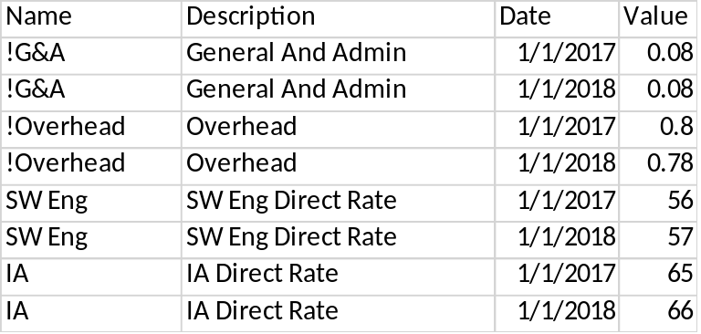
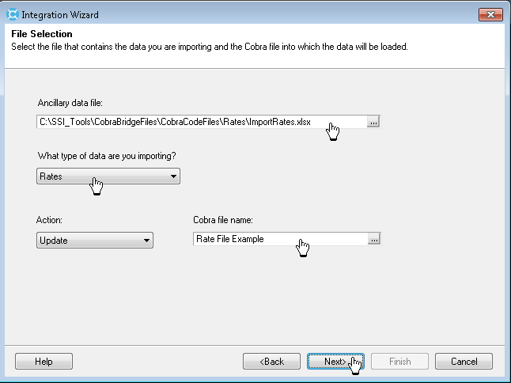
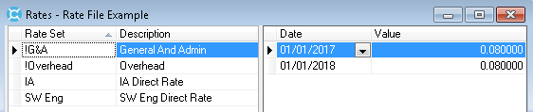
Cobra - New Project Setup Procedure
Rate Files - Making and Using Rate Files in Cobra
  Import Rates from an Excel or CSV file Using the Ancillary Data Integration Wizard
    Make a new Rate file using the New Rate File Wizard by following Steps 1 – 5 on the previous page.
    Make a Rate set import file in Excel or CSV like the example shown left. The import file will have a column for the Rate Name, Description, effective Date and Value.
    Note - Date identifies the first date when its value is effective. The value does not change again until the next effective date.
    Select Ancillary Data from Cobra’s Integration menu
    Follow the Integration Wizard import Instructions for rates just as you did for code files
    Open the Imported Rates using the Cobra Navigation Pane to see the Rate file data.

Slide 18

Cobra - New Project Setup Procedure
Resource Files - Making and Using Resource Files in Cobra
  The resource table is a list of Labor, Materials, Subcontractors and Other costs used in a project. The Resource File is where a Cobra user applies Rates from Rate Sets to calculate project budgets and estimates.
  The components of a Rate File are as follows:
    Resource name & Description is the identifying name and description of the resource
    Calculations lists each Rate Set that applies to the Resource such as Direct Rate / Hour, Overhead, General And Administrative rate and so on.
    Calculations Source Results shows the order Rate Set values are applied. For example, the Direct Rate is typically applied to Resource Hours. Overhead is then added to the product of Hours times Direct. General And Administrative is then added to the product of (Hours times Direct) plus (Hours times Direct) times Overhead.
  In the example below, a SW Engineer (a resource from the Resource file) has a Direct rate for each Hour of $56/hour (from the Rate file). Then, Overhead and G&A (also from the Rate file) are applied in turn to yield the budgeted or estimated cost for 1 hour of a SW Engineer of $108.86
Rate Set Name | Description | Value
SW Eng | SW Eng Direct Rate | $56.00
!Overhead | Overhead | .8
!G&A | General And Admin | .08
Resource from Resource File –
SW Engineer 1 (1 Hour)
Direct Rate for 1 Hour = $56
Add Overhead = $56 + (.8 X $56) = $100.8
Add G&A = $100.8 = (.08 X 100.8) = $108.86

Slide 19
Cobra - New Project Setup Procedure
Resource Files - Making and Using Resource Files in Cobra
  How to Make a Cobra Resource File using the New Resource File Wizard
    Start Cobra and Select the Cobra Explorer
    Right-Click on Resources and select New Resource File
    Enter the Resource File Name & Description then Click Next
    Using the Resource File Structure form, Select “Non Significant” as the Type then Click Next.
    Note - If needed you can choose “Punctuation Significant” or “Fixed Form Significant” if you need a hierarchical structure in the resource file. See Page 12 for more on these three options.
    Use the Thresholds page to define acceptable cost and schedule variances then Click Next.
    Note - When a cost variance or schedule variance exceeds the predefined threshold, they are highlighted in either red for unfavorable (negative) or green for favorable (positive. These thresholds, or tolerances, define how large cost variances (Earned Value - Actual Cost) and/or schedule variances (Earned Value - Budget) must be before Cobra triggers exception reporting mechanisms.
    Using the Code Fields form, enter up to 9 codes fields that can be used with Resources then Click Next
    Using the Default Rates form, select the Rate File that will be used to determine the planned and estimated costs of Resources then Click Next
    Using the form named Resource Results select calculation result factors that will be applied to resources such as Hours, Fee, Overhead, G&A, Cost of Money and so on then Click Next
    Note - Scroll to the right on this page and enter Unit (unit for measure), Default Rate Set, Currency and Result Code if needed.
    Use the Access Control form to add Users or classes of users such as SYSADMIN or GUEST if necessary then Click Finish
    Click Add Resources and Add Child Resources on the Edit menu or Import Resources using the Integration Wizard

Slide 20
Cobra - New Project Setup Procedure
Resource Files - Making and Using Resource Files in Cobra
  How to Make a Cobra Resource File using the New Resource File Wizard
    Start Cobra and Select the Cobra Explorer
    Right-Click on Resources and select New Resource File
    Enter the Resource File Name & Description then Click Next
    Using the Resource File Structure form, Select “Non Significant” as the Type then Click Next.
    Note - If needed you can choose “Punctuation Significant” or “Fixed Form Significant” if you need a hierarchical structure in the resource file. See Page 12 for more on these three options.
    Use the Thresholds page to define acceptable cost and schedule variances then Click Next.
    Note - When a cost variance or schedule variance exceeds the predefined threshold, they are highlighted in either red for unfavorable (negative) or green for favorable (positive. These thresholds, or tolerances, define how large cost variances (Earned Value - Actual Cost) and/or schedule variances (Earned Value - Budget) must be before Cobra triggers exception reporting mechanisms.
    Using the Code Fields form, enter up to 9 codes fields that can be used with Resources then Click Next
    Using the Default Rates form, select the Rate File that will be used to determine the planned and estimated costs of Resources then Click Next
    Using the form named Resource Results select calculation result factors that will be applied to resources such as Hours, Fee, Overhead, G&A, Cost of Money and so on then Click Next
    Note - Scroll to the right on this page and enter Unit (unit for measure), Default Rate Set, Currency and Result Code if needed.
    Use the Access Control form to add Users or classes of users such as SYSADMIN or GUEST if necessary then Click Finish
    Click Add Resources and Add Child Resources on the Edit menu or Import Resources using the Integration Wizard

Slide 21
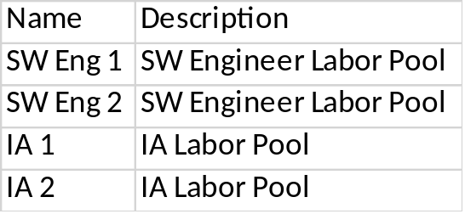
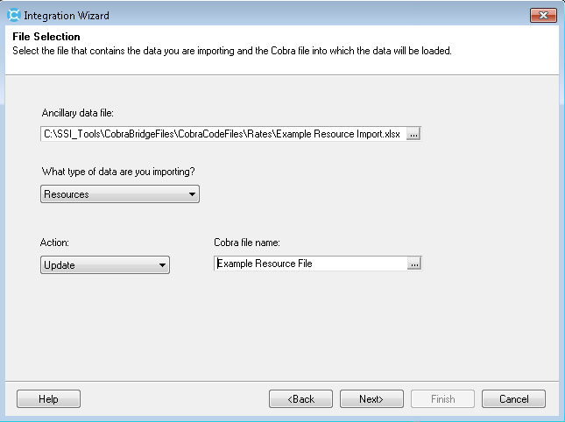
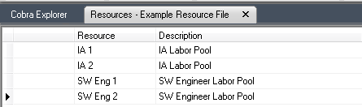
Cobra - New Project Setup Procedure
Resource Files - Making and Using Resource Files in Cobra
  Import Resources from an Excel or CSV file Using the Ancillary Data Integration Wizard
    Make a new Resource file using the New Resource File Wizard by following Steps 1 – 9 on the previous page.
    Make a Resource import file in Excel or CSV like the example shown left. The import file will have a column for the Resource Name, Description.
    Select Ancillary Data from Cobra’s Integration menu
    Follow the Integration Wizard import Instructions for Resources
    Open the Imported Resource file using the Cobra Navigation Pane to see Resource file data.

Slide 22
Cobra - New Project Setup Procedure
Resource File Calculations – Adding Calculated Values to the Resources File
  Use the Calculations tab of the Resource file to add results and calculations to a resource.
  This tab consists of two panes: the left pane (Calculation pane) displays the calculation results available for the resource, and the right pane (Source Results pane) displays the factors used to calculate results such as Direct Cost, Burdened Costs, Total Costs and Full Time Equivalent Heads.
  The components of the Left pane of Calculations, named Calculation, are:
    Field Name & Result is the identifying name of the Calculated result such as Hours, Direct, Overhead GANDA (short for General and Administrative)
    Units shows the Unit of Measure for the such as Dollars, Hours, Heads and so on
    Rate Set is a reference to an item in the Rate file that contains the calculation factor for the item
    Currency is a check box showing that the item is in dollars
    Result Code is a short name for the item such as “H” for Hours and “O” for Overhead
    Right-click in the left pane of Calculations to add calculated Results (Add Results)
  The components of the Right pane of Calculations, named Source Results are:
    Check Boxes used to indicate how to apply calculation items.
    To calculate the Direct value of labor, for example you would check Hours, meaning that direct costs are Hours times the Direct rate. If Overhead is added next, then the Overhead source result checks would be on Direct (which is the product of the Hours times Direct)

Slide 23
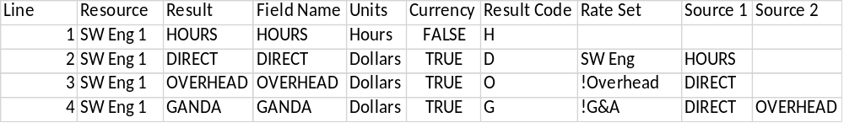
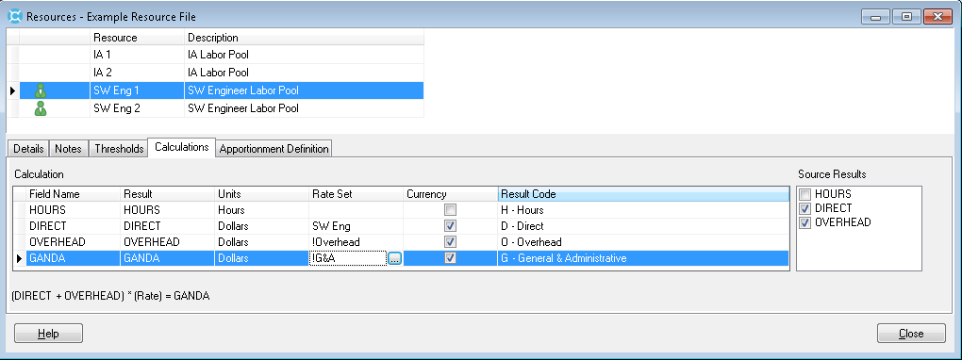
Cobra - New Project Setup Procedure
Resource File Calculations – Importing Calculated Values to the Resources File
  Adding Calculations manually is time consuming. Importing may be a better solution of you are creating a new Resource file with many Resource names.
    Make a Resource Calculation import file using the file structure shown below
    Select Ancillary Data from Cobra’s Integration menu to import Resource Calculation and Follow the instruction using the Integration Wizard
Source 1, Source 2 and so on are equivalent to the number of checked boxes in the Right pane of Resource Calculations
Notes – Line 1, 2, 3, 4, and so on correspond to the calculation result items shown in left pane of Resource Calculations

Slide 24
Cobra - New Project Setup Procedure
Make a New Cobra Project with Calendars, Codes, Rates, Resources and Resource Calculations
Once you have a Calendar file, Code files, Rate file, Resource files and Resource Calculations, your are ready to create a new project
    Right Click on Projects and Select New Project File
    Enter a Project Name and Description on the New Project form, then click Next
    Note – check Copy defaults from project if you have a similar project with similar code, calendar and resource files
    Using the Fields form, Select the Code file for Control Account Field 1 (WBS by default), Control Account Field 2 (OBS by Default) and Control Account Field 3 (Blank by Default). At a minimum, use just the first Control Account Field 1 (WBS)
    Using the Fields form to specify CAM and Charge Number code files if needed
    Use the Ancillary Files form to specify the Calendar file, Rate file and Resource file
    Use Settings to specify the level at which to capture actual costs (Work Package is recommended otherwise you may not be able to enter Estimate to Complete at the work package level)
    Use the Project Dates form to enter the project’s baseline and forecast period of performance
    Enter Project level codes if needed or just click Next
    Use the Access Control form to add Users or classes of users such as SYSADMIN or GUEST if necessary then click Finish

Slide 25
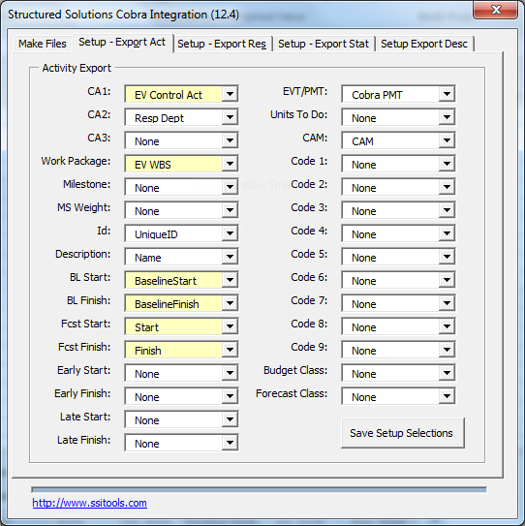
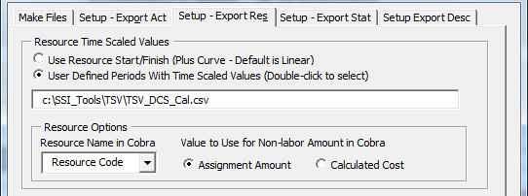
Cobra - New Project Setup Procedure
Generate Import Data From a Microsoft Project File Using SSI Cobra Bridge tools
  Once you have a Project created, you can import Control Accounts and Work Packages, Resource Assignments, Status, Code Assignments and User fields and Actual Costs
    Make a Microsoft project file and add fields for the Cobra data shown in the table
    Configure the SSI Tools Cobra Bridge Setup – Export Act and Setup Export Res pages as shown below and Click Save Setup Selections
Custom Field Name | Note
EV Control Account | This is the parent WBS for the Work Package and must be the same parent WBS for Actual Charges
EV WBS | Work Package ID
Name | This is used for the Work Package Description in Cobra
Cobra PMT | This is used for the Progress Technique in Cobra (See progress technique codes on next pages
Resource Code | Used to match the Resource name in the Cobra Resource table
Resp Dept | This is an optional field that could be used for OBS

Slide 26
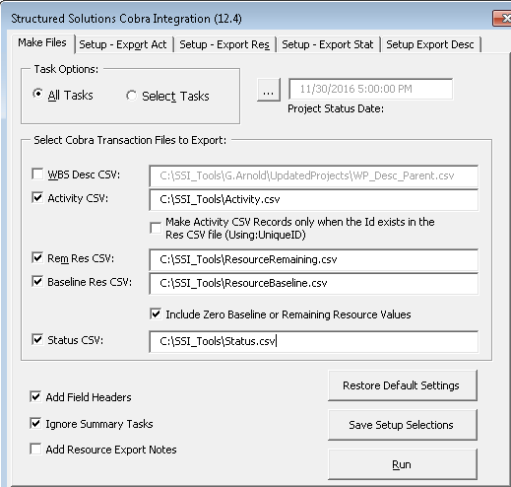
Cobra - New Project Setup Procedure
Generate Import Data From a Microsoft Project File
  Click the SSI Cobra Bridge tool page named Make Files
  When making or changing a baseline select Activity CSV, Baseline Res CSV
  When updating Project Status and the Estimate to Complete, Click Activity CSV, Rem Res CSV and Status CSV
  Then Click Run

Slide 27
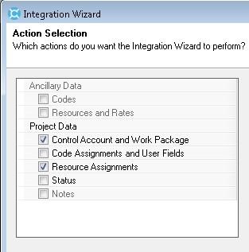
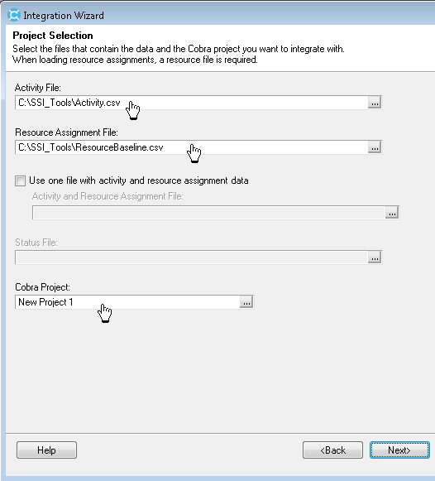
Cobra - New Project Setup Procedure
Importing Baseline Data From a Microsoft Project File
  Select Files from the Cobra Integration menu
  Use the Integration Configuration form to Create or Open an existing configuration for import data. Select Files below “Where are you loading the data from” question and click Next
  Use the Action Selection form to select Control Account and Work Package and Resource Assignments on then click Next
  Use the form named Project Selections to select the Activity File and the Resource Assignment File that was created by SSI Tools. Use the ResourceBaseline.csv file (or another name if used) when creating or updating a baseline

Slide 28
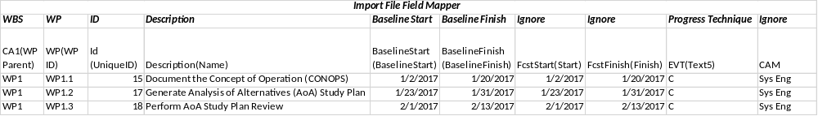
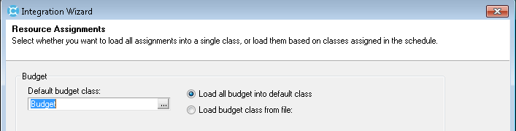
Cobra - New Project Setup Procedure
Importing Baseline Data From a Microsoft Project File
  Use the Import File Field Mapper to map columns in the SSI Tools generated Activity CSV file for WBS, WP, ID, Description, Baseline Start, Baseline Finish, and Progress Technique as shown below
  Use the Progress form to select the option named Load Progress Technique from file then click Next
  Use the Resource Assignments form to select Budget for the option named Default budget class and Load all budget into default class
  Click Next using each forms
  default values until you get to
  the form named Confirmation,
  then click Finish
  Inspect imported data using
  the Cobra Project Explorer

Slide 29
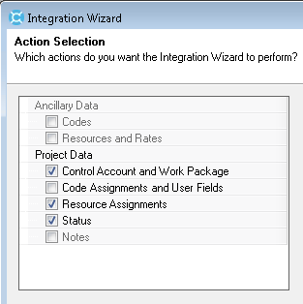
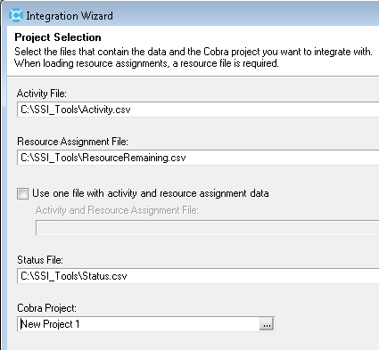
Cobra - New Project Setup Procedure
Importing ETC and Status Data From a Microsoft Project File
  Select Files from the Cobra Integration menu
  Use the Integration Configuration form to Create or Open an existing configuration for import data. Select Files below “Where are you loading the data from” question and click Next
  Use the Action Selection form to select Control Account and Work Package, Resource Assignments and Status on then click Next
  Use the form named Project Selections to select the Activity File, Resource Assignment File and Status File that was created by SSI Tools. Use the ResourceRemaining.csv file (or another name if used) when creating or updating a baseline

Slide 30
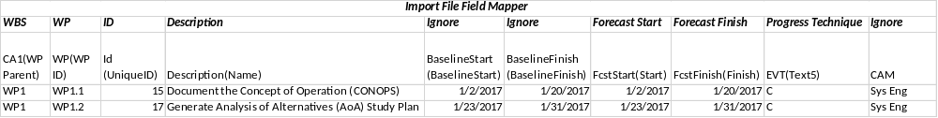
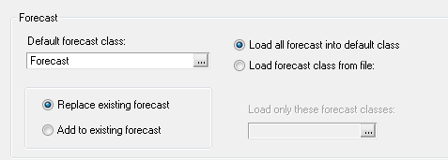
Cobra - New Project Setup Procedure
Importing ETC and Status Data From a Microsoft Project File
  Use the Import File Field Mapper to map columns in the SSI Tools generated Activity CSV file for WBS, WP, ID, Description, Forecast Start, Forecast Finish, and Progress Technique as shown below
  Use the Progress form to select the option named Load Progress Technique from file then click Next
  Use the Resource Assignments form to select Forecast for the option named Default forecast class and Load all forecast into default class

Slide 31
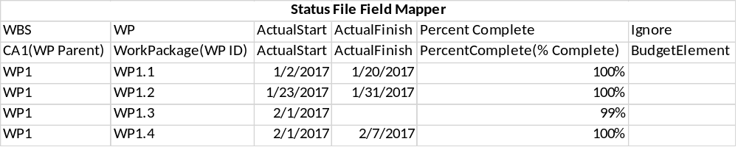
Cobra - New Project Setup Procedure
Importing ETC and Status Data From a Microsoft Project File
  Click Next using each forms default values until you get to the form named Status File Field Mapper. Map columns in the SSI Tools generated Status CSV file for WBS, WP, Actual Start, Actual Finish, and Percent Complete as shown below
  Click Next using each forms default values until you get to the form named Confirmation, then click Finish
  Inspect imported data using the Cobra Project Explorer

Slide 32
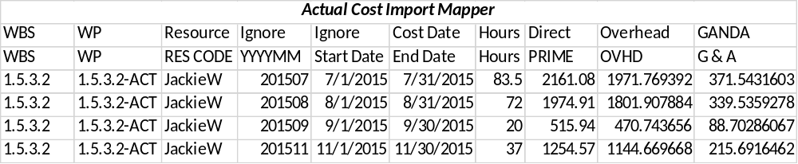
Cobra - New Project Setup Procedure
Importing Actual Costs
  Select Actual Costs from the Integration menu and use the Actual Cost Field Mapper to map WBS, WP, Resource, Cost Date, Hours, Direct, Overhead, GANDA as shown below
  Follow the instructions for Importing Actuals.
  Note – Actual costs are imported at the Work Package Level, therefore a project’s WBS Code File must have at least one work package below the Control Account level to receive Actual Costs. In the example table above, 1.5.3.2-ACT is the work package that receives imported actual values. Actual Cost work packages may not exist in Microsoft Project and may need to be created in the WBS code file for a project.

Slide 33
Common Earned Value Performance Techniques
Field | Description
Level of Effort (A) | This progress technique assumes that when a work package starts, its progress will not deviate from the original budget spread. Cobra lets you apply this progress technique to any work package, but it is most suitable for only a small number of work packages whose earned value is, by nature, unmeasurable. The value earned by an open work package using this progress technique is equal to its budget to date. The value earned each period equals the budget. In other words, the work package earns its entire budget up to the status date. An LOE work package should be set to In-progress before its baseline start date. If the work package is in a status period after the baseline start date, Cobra puts a cumulative-to-date earned value record in the current period. Similarly, if you change the budget in the previous period, Cobra puts a correcting entry in the current period. This ensures that cumulative-to-date earned value is equal to the cumulative-to-date budget.
% Complete (C) | Use this progress technique if you want to manually enter the completion status of the work package as a percentage each status period. For example, if you enter 20 in the Completed field on the General tab of the Project view, 20% of the work package has been earned.
50-50 (E) | With this progress technique, 50% of the value is earned as soon as the work package starts, and the rest is earned when it is completed. Use this progress technique only for work packages that span a maximum of two periods, since value cannot be earned in any intervening periods. For example, if you apply the 50-50 progress technique to a work package spanning 4 months, the work package cannot earn any value during the second and third months (assuming it does not finish early).
0-100 (F) | If you select this progress technique, no value is earned until the work package is completed, at which point the entire budget is earned. Use this progress technique only if the work package is scheduled to start and finish in the same period.
User Defined (H) | This is a variation of the 50-50 progress technique (E). The percentage earned at the start of the work package (1 to 99%) is defined in advance by the user. The remaining percentage is earned when the work package is completed. This method should be used only for work packages whose schedule dates span a maximum of two fiscal periods.
Planning Package (K) | When you use this progress technique, Cobra always calculates an earned value of zero for the item. Use this progress technique if you do not want the work package to earn any of its budget, regardless of its status.

Slide 34
Additional Earned Value Performance Techniques
Field | Description
Milestones (B) | With this progress technique, milestones are defined, and relative weights are assigned to them. At any point, the value earned is the original work package budget multiplied by the combined weight of the completed milestones and divided by the total weight of all milestones. You can apply this method to any work package. It is generally the preferred method for work packages that span more than two fiscal periods. Cobra also provides a project option that allows you to define progress on a milestone as a percent complete.
Units Complete (D) | Sometimes referred to as the “discrete” method, this progress technique is applicable to any work package that is made up of a predefined number of similar tasks. The value earned at any point in time is simply the work package budget multiplied by the number of these tasks completed and divided by the total number to be done. Use of this progress technique assumes that budgets are based on the units being measured.
100-0 (G) | All the value is earned as soon as the work package is started. Use this method only if the work package is scheduled to start and finish in the same fiscal period.
User Defined (H) | This is a variation of the 50-50 progress technique (E). The percentage earned at the start of the work package (1 to 99%) is defined in advance by the user. The remaining percentage is earned when the work package is completed. This method should be used only for work packages whose schedule dates span a maximum of two fiscal periods.
Apportioned (J) | With this progress technique, the work package budget is earned in direct proportion to the amount earned on another related work package. You can apply this progress technique to any work package if the referenced work package does not itself use the Apportioned or the Level of Effort progress technique, and if the schedule dates are the same for both work packages. This progress technique is generally used when the activity itself is difficult to measure, but it is closely related to a more readily measured work package. Quality assurance is a typical example of this type of work package. Note: The Apportioned progress technique is not supported for the integration process. If you want to use this progress technique for integration, you must manually select it on the General tab of the Project view.
Assignment % Complete (L) | This progress technique lets you enter a percent complete for each resource individually. This is useful when you have long work packages and your resources are not spread across the entire work package. This is not a recommended method for work packages that contain apportionment resources because Cobra will be unable to determine the status of the apportioned resources.
Calculated Apportionment (M) | This progress technique is associated with an apportioned budget. Cobra allows you to define budget items based on a percentage of other items, such as defining travel as a percentage of engineering. Work packages that use this progress technique can calculate earned value based on the same formula.
Steps (N) | This progress technique lets you define the steps and weight used in calculating the percent complete of the work package. When you add a step, the work package earns a percentage of the work package's budget. This method is similar to Milestones (B) except that dates are not entered.
Earned As Spent (O) | This progress technique calculates the percent complete of a work package based on actual costs, using the formula (Actual Cost/EAC) x 100. If Actual Cost exceeds the BAC, the earned value will equal the budget. This method is useful for progressing material items to reduce false variances. When actual costs are collected at the work package level, the percent complete is calculated using the total earned and BAC values at the work package level. When actual costs are collected at the control account level, the BAC is calculated using the sum of the work packages and the same percentage complete is applied to all work packages with a status of In-progress. If the Allow percent complete on milestones option is selected in the Project Preferences tab in the Project Properties dialog box, Cobra uses the percentage complete approach in calculating earned value by weighted steps. Each step can have a portion earned, rather than forcing an all-or-nothing awarding of earned value.
% Complete Manual Entry (P) | This progress technique calculates earned value using the same method as % Complete. However, Cobra does not update work packages using this method when status is loaded from the schedule.

